Slide 1
Weekly Update 6

Slide 2
CNCF(Cloud Native Computing Foundation)
Documentation and outcomes of an in-depth threat modelling exercise performed against a generic Kubernetes cluster
Each component of the Kubernetes architecture was analysed using the STRIDE methodology to identify potential security issues at the trust boundaries within the platform

Slide 3
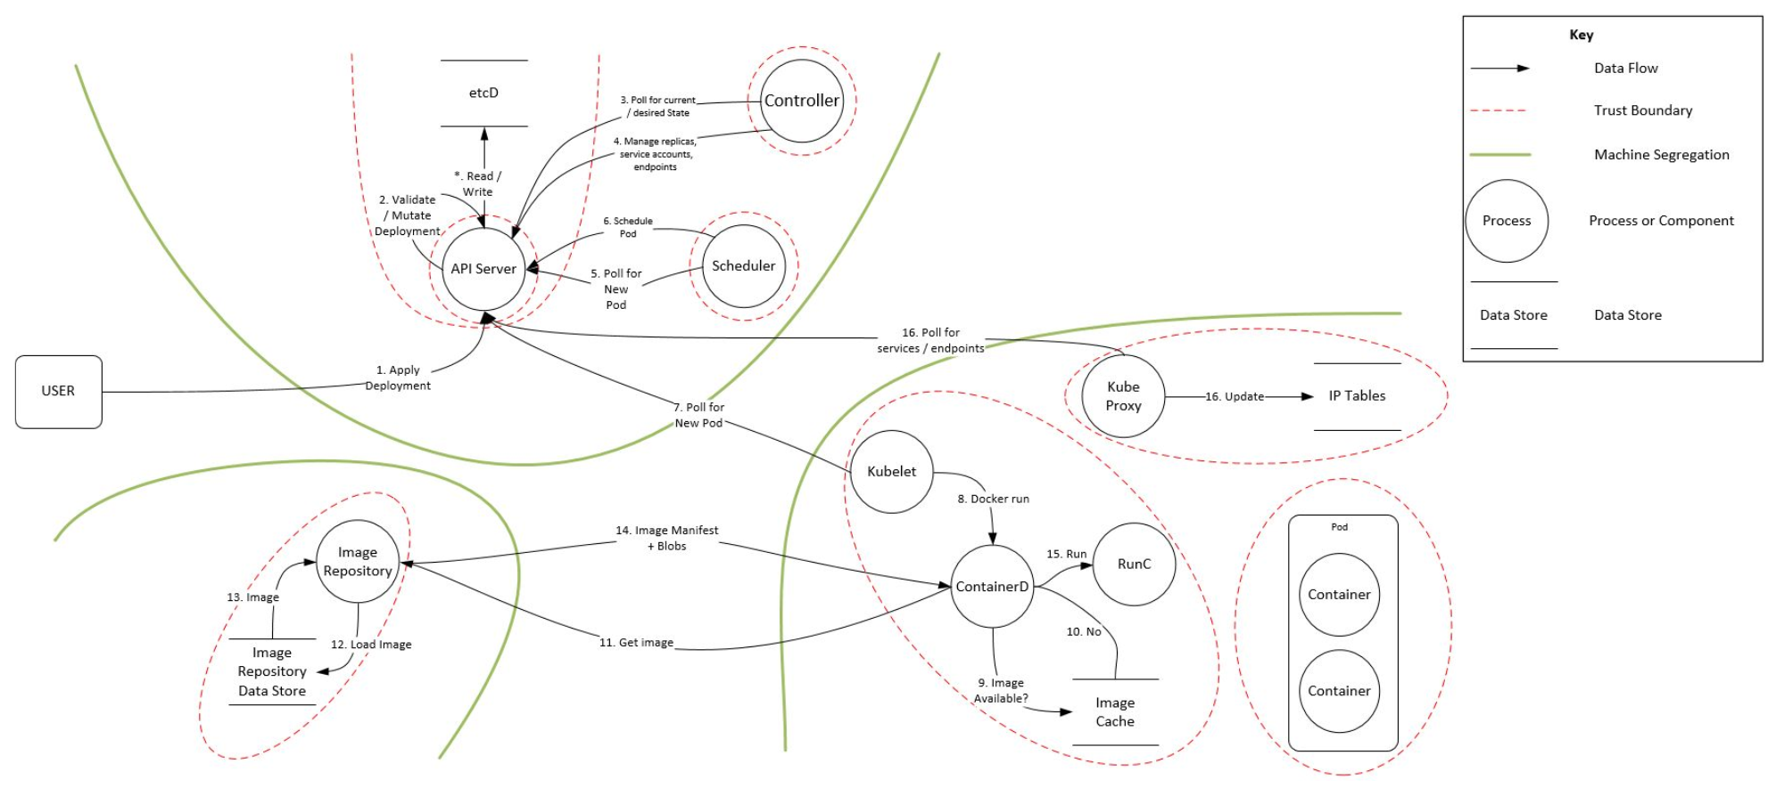
Kubernetes Trust Boundaries

Slide 4
Main Attack Vectors
Service token
Compromised container
Network endpoints
Denial of service
RBAC issues

Slide 5
Attack Trees
Bottom up Approach: This approach shows entry points throughout the Kubernetes platform with the aim of satisfying the stated goal.
Scenario Approach: Scenario based view, identifying attack vectors open to an attacker in certain scenarios.

Slide 6
Attack Tree
•Malicious code execution (bottom up)
•Establish persistence (bottom up)
•Access sensitive data (bottom up)
•Denial of service (bottom up)
•Compromised application leads to foothold in container (scenario)
•Attacker on the network (scenario)

Slide 7
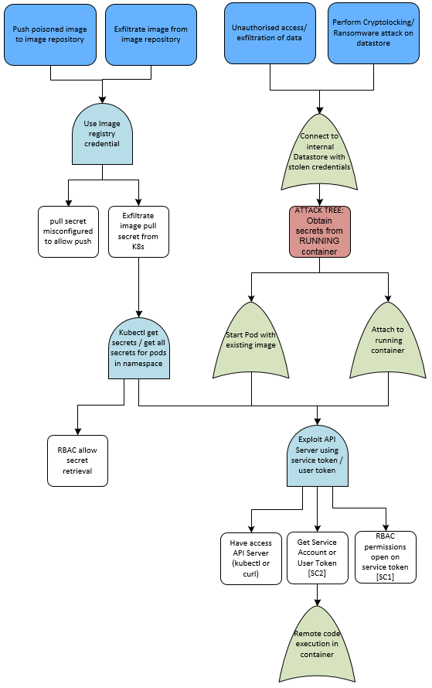
Attack Via Compromised Container

Slide 8
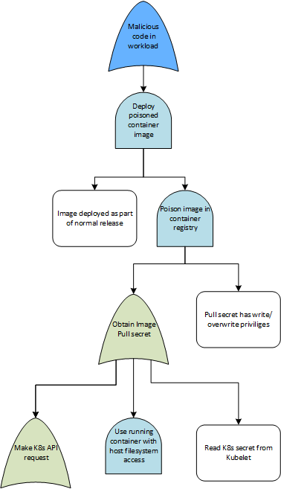
Attack Via Malicious Pull Sheet

Slide 9
References
K8S Threat Model - CloudSecDocs
The Current State of Kubernetes Threat Modelling | Marco Lancini's Blog

